Slide 1

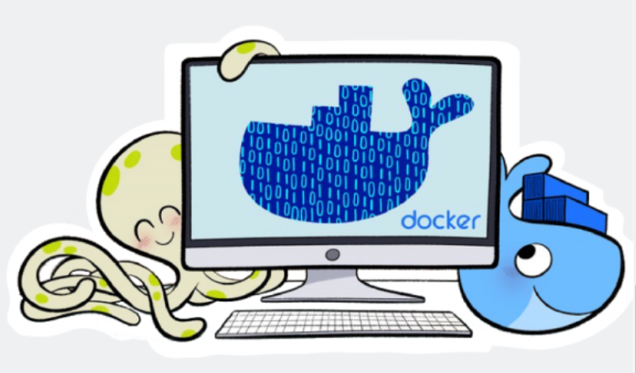
B
Y
K
U
M
A
R
Notes:
https://docs.docker.com/samples/
https://docs.docker.com/get-started/

Slide 2
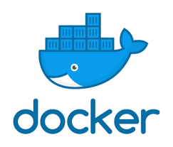
Docker is a software platform that allows you to build, test, and deploy applications quickly.
What is Docker?

Slide 3
Docker is a software platform that allows you to build, test, and deploy applications quickly.
Lightweight, open, secure platform.
What is Docker?

Slide 4
Docker is a software platform that allows you to build, test, and deploy applications quickly.
Lightweight, open, secure platform.
Runs natively on Linux or Windows Server.
What is Docker?

Slide 5
Docker is a software platform that allows you to build, test, and deploy applications quickly.
Lightweight, open, secure platform.
Runs natively on Linux or Windows Server
Runs on Windows or Mac Development machines (with a virtual machine)
What is Docker?

Slide 6
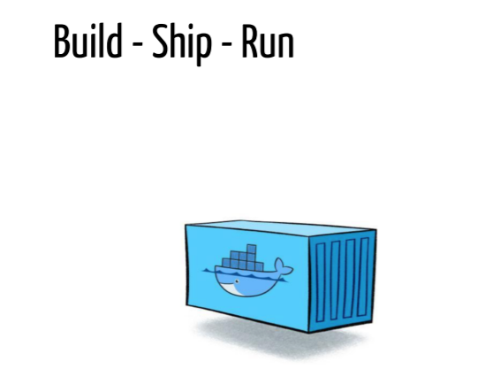
What is Docker?

Slide 7
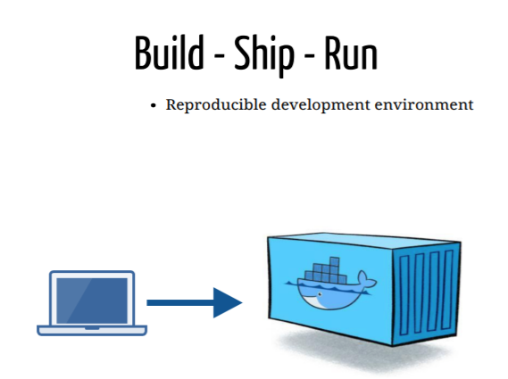
What is Docker?

Slide 8
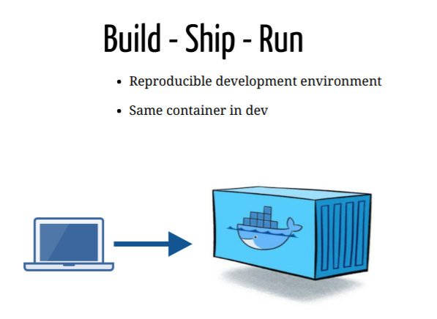
What is Docker?

Slide 9
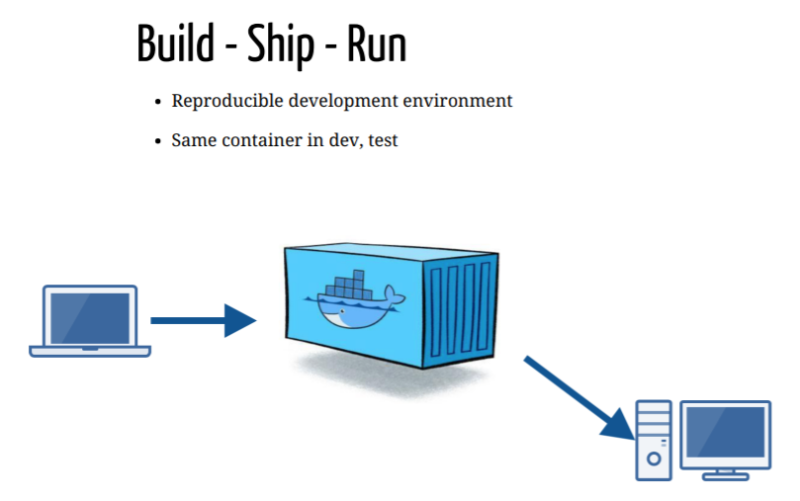
What is Docker?

Slide 10
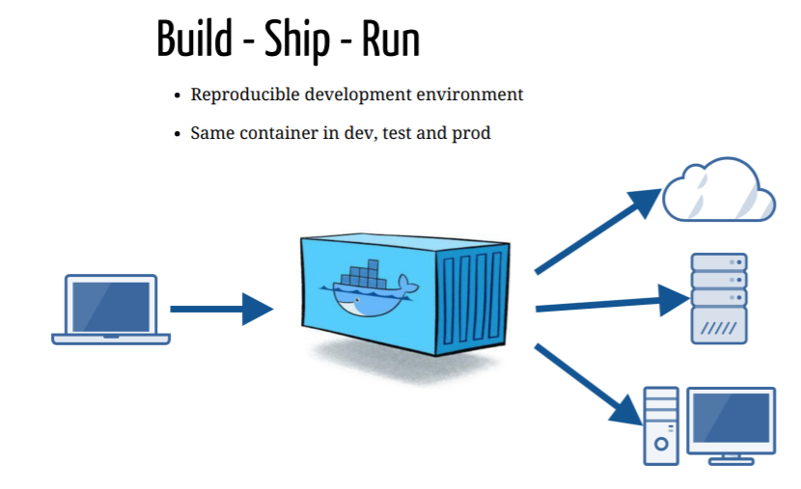
What is Docker?

Slide 11
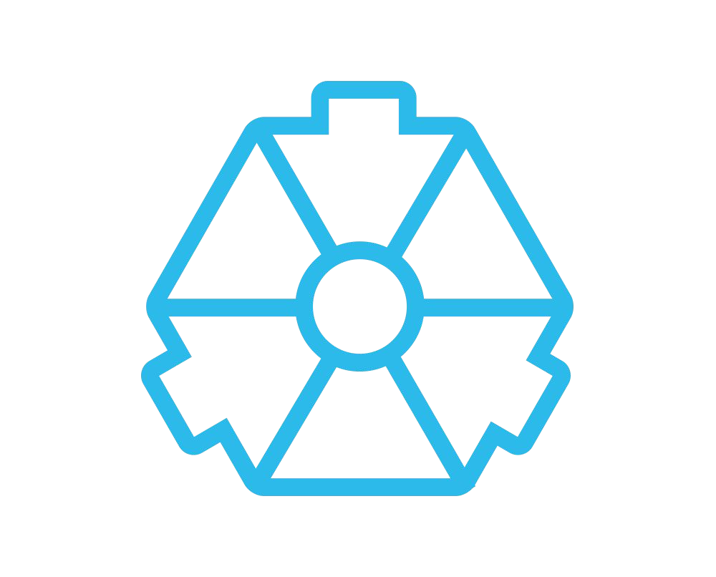
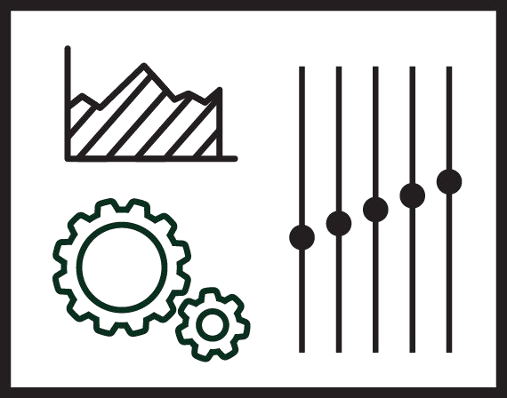
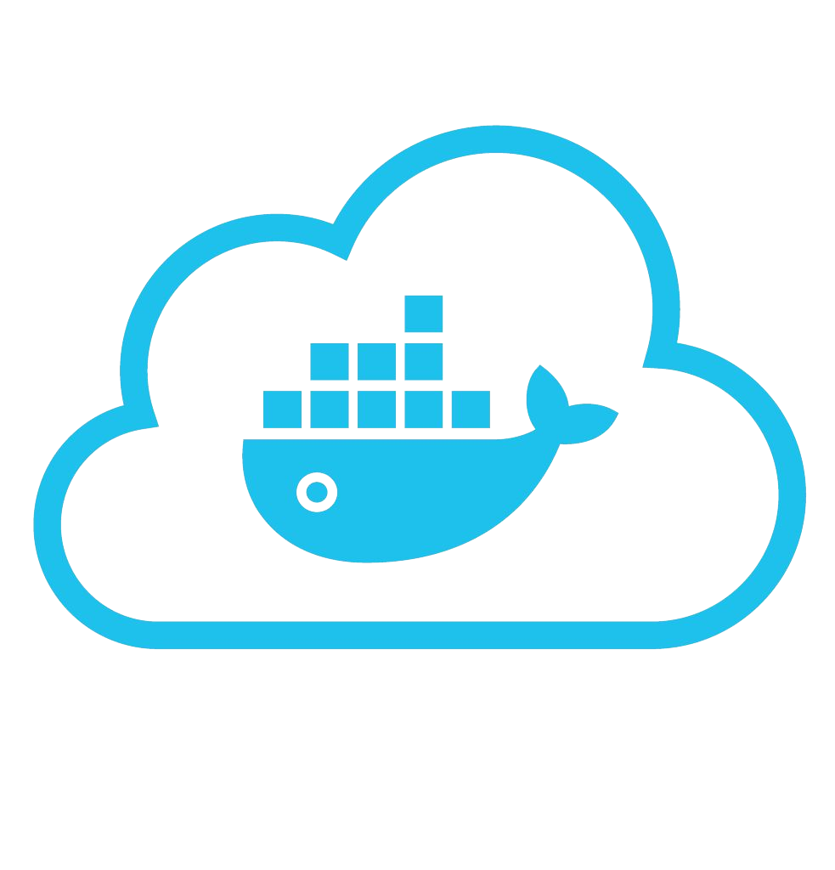





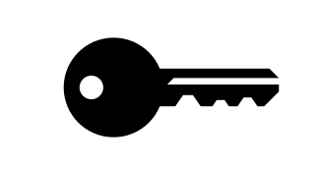



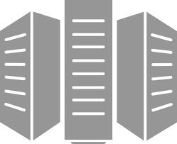



Docker: Build, Ship, Run Workflow
Developers IT Operations
BUILD
Development Environments
SHIP
Create & Store Images
RUN
Deploy, Manage, Scale

Slide 12
B
Y
K
U
M
A
R
Notes:
https://docs.docker.com/samples/
https://docs.docker.com/get-started/

Slide 13
Overview of Docker editions
Docker is available in two editions:
Community Edition (CE)
Enterprise Edition (EE)

Slide 14
Overview of Docker editions
Docker is available in two editions:
Community Edition (CE)
Enterprise Edition (EE)
Docker Community Edition (CE) is ideal for individual developers and small teams looking to get started with Docker and experimenting with container-based apps.

Slide 15
Overview of Docker editions
Docker is available in two editions:
Community Edition (CE)
Enterprise Edition (EE)
Docker Community Edition (CE) is ideal for individual developers and small teams looking to get started with Docker and experimenting with container-based apps.
Docker Enterprise Edition (EE) is designed for enterprise development and IT teams who build, ship, and run business critical applications in production at scale.

Slide 16
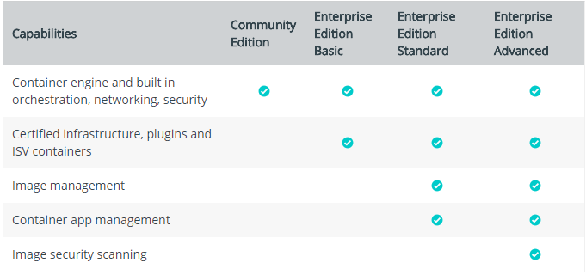
Overview of Docker editions

Slide 17
B
Y
K
U
M
A
R
Notes:
https://docs.docker.com/samples/
https://docs.docker.com/get-started/

Slide 18
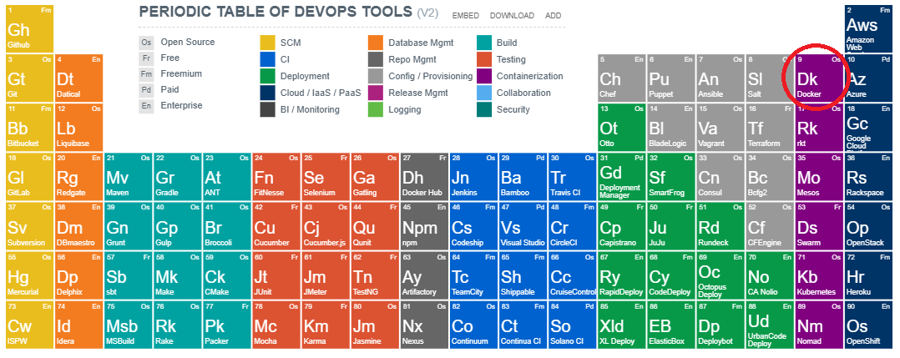
Docker and DevOps Tools

Slide 19
B
Y
K
U
M
A
R
Notes:
https://docs.docker.com/samples/
https://docs.docker.com/get-started/

Slide 20
Terminology
Images - The file system and configuration of our application which are used to create containers.

Slide 21
Terminology
Images - The file system and configuration of our application which are used to create containers.
Containers - Running instances of Docker images — containers run the actual applications. A container includes an application and all of its dependencies. It shares the kernel with other containers, and runs as an isolated process in user space on the host OS.

Slide 22
Terminology
Images - The file system and configuration of our application which are used to create containers.
Containers - Running instances of Docker images — containers run the actual applications. A container includes an application and all of its dependencies. It shares the kernel with other containers, and runs as an isolated process in user space on the host OS.
Docker daemon - The background service running on the host that manages building, running and distributing Docker containers.

Slide 23
Terminology
Images - The file system and configuration of our application which are used to create containers.
Containers - Running instances of Docker images — containers run the actual applications. A container includes an application and all of its dependencies. It shares the kernel with other containers, and runs as an isolated process in user space on the host OS.
Docker daemon - The background service running on the host that manages building, running and distributing Docker containers.
Docker client - The command line tool that allows the user to interact with the Docker daemon.

Slide 24
Terminology
Images - The file system and configuration of our application which are used to create containers.
Containers - Running instances of Docker images — containers run the actual applications. A container includes an application and all of its dependencies. It shares the kernel with other containers, and runs as an isolated process in user space on the host OS.
Docker daemon - The background service running on the host that manages building, running and distributing Docker containers.
Docker client - The command line tool that allows the user to interact with the Docker daemon.
Docker Store - A registry of Docker images, where you can find trusted and enterprise ready containers, plugins, and Docker editions.

Slide 25
B
Y
K
U
M
A
R
Notes:
https://docs.docker.com/samples/
https://docs.docker.com/get-started/

Slide 26
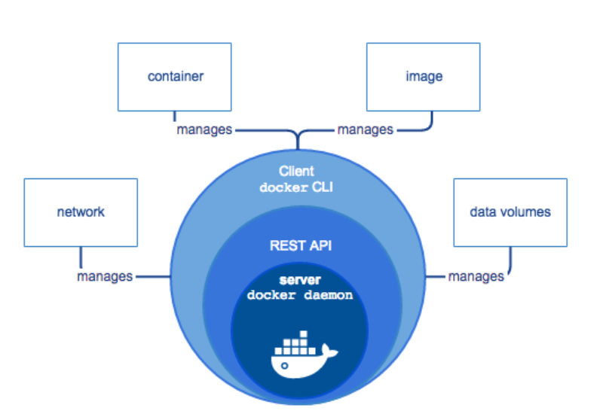
Docker Engine

Slide 27
B
Y
K
U
M
A
R
Notes:
https://docs.docker.com/samples/
https://docs.docker.com/get-started/

Slide 28
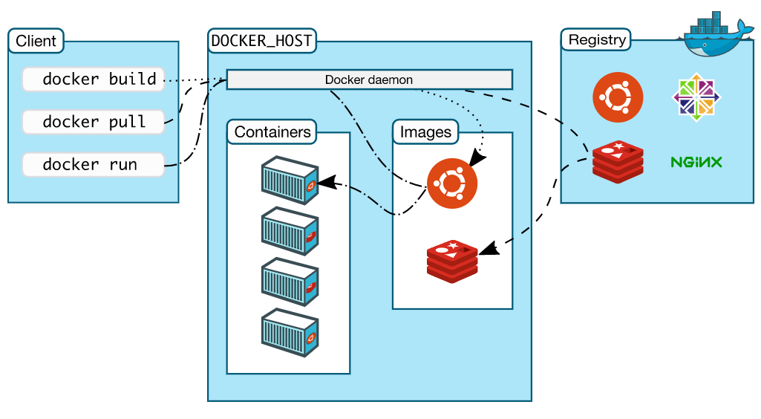
Docker Architecture

Slide 29
B
Y
K
U
M
A
R
Notes:
https://docs.docker.com/samples/
https://docs.docker.com/get-started/

Slide 30
What is / Why Docker Container?
?????

Slide 31
What is / Why Docker Container?
Standard Machine
Virtual Machine
Docker Container
???????????

Slide 32
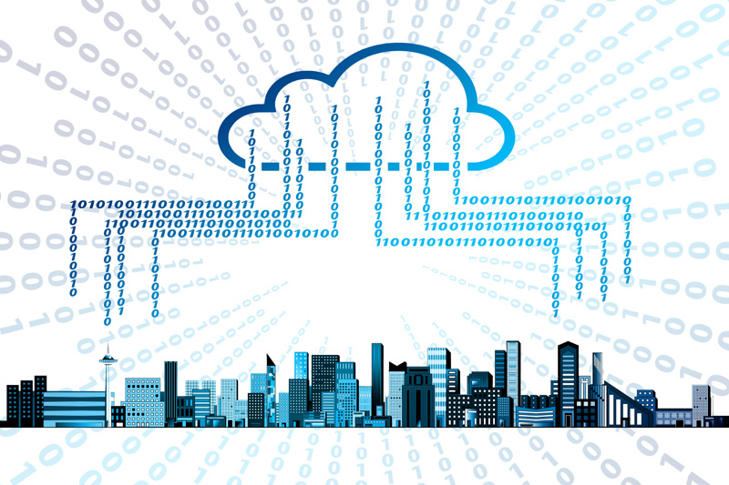
What is / Why Docker Container?
Standard Machine
App A
App B
App C
Bins/Libs
Host OS

Slide 33
Virtual Machine
Why Docker Container?
Standard Machine
VM 1
MV 2
MV 3
App A
App B
App C
Bins/
Libs
Bins/
Libs
Bins/
Libs
App A
App B
App C
Guest OS
Guest OS
Guest OS
Bins/Libs
Hypervisor
Host OS
Host OS
Infrastructure
Infrastructure

Slide 34
Standard Machine
Virtual Machine
Docker Container
MV 1
MV 2
MV 3
App A
App B
App C
Docker Container 1
Docker Container 2
Docker Container 3
Bins/
Libs
Bins/
Libs
Bins/
Libs
App A
App B
App C
App A
App B
App C
Guest OS
Guest OS
Guest OS
Bins/
Libs
Bins/
Libs
Bins/
Libs
Bins/Libs
Hypervisor
Docker Engine
Host OS
Host OS
Host OS
Infrastructure
Infrastructure
Infrastructure

Slide 35
Standard Machine
Virtual Machine
Docker Container
App A will have their own Bins/Libs
MV 1
MV 2
MV 3
App A
App B
App C
Docker Container 1
Docker Container 2
Docker Container 3
Bins/
Libs
Bins/
Libs
Bins/
Libs
App A
App B
App C
App A
App B
App C
Guest OS
Guest OS
Guest OS
Bins/
Libs
Bins/
Libs
Bins/
Libs
Bins/Libs
Hypervisor
Docker Engine
Host OS
Host OS
Host OS
Infrastructure
Infrastructure
Infrastructure
Notes:
Application App A will have their own Bins/Libs.

Slide 36
Standard Machine
Virtual Machine
Docker Container
App B will have their own Bins/Libs
MV 1
MV 2
MV 3
App A
App B
App C
Docker Container 1
Docker Container 2
Docker Container 3
Bins/
Libs
Bins/
Libs
Bins/
Libs
App A
App B
App C
App A
App B
App C
Guest OS
Guest OS
Guest OS
Bins/
Libs
Bins/
Libs
Bins/
Libs
Bins/Libs
Hypervisor
Docker Engine
Host OS
Host OS
Host OS
Infrastructure
Infrastructure
Infrastructure
Notes:
Application App B will have their own Bins/Libs.

Slide 37
Standard Machine
Virtual Machine
Docker Container
App C will have their own Bins/Libs
MV 1
MV 2
MV 3
App A
App B
App C
Docker Container 1
Docker Container 2
Docker Container 3
Bins/
Libs
Bins/
Libs
Bins/
Libs
App A
App B
App C
App A
App B
App C
Guest OS
Guest OS
Guest OS
Bins/
Libs
Bins/
Libs
Bins/
Libs
Bins/Libs
Hypervisor
Docker Engine
Host OS
Host OS
Host OS
Infrastructure
Infrastructure
Infrastructure
Notes:
Application App C will have their own Bins/Libs.

Slide 38
Standard Machine
Virtual Machine
Docker Container
Guest OS occupied more resources, CPU and Disk
MV 1
MV 2
MV 3
App A
App B
App C
Docker Container 1
Docker Container 2
Docker Container 3
Bins/
Libs
Bins/
Libs
Bins/
Libs
App A
App B
App C
App A
App B
App C
Guest OS
Guest OS
Guest OS
Bins/
Libs
Bins/
Libs
Bins/
Libs
Bins/Libs
Hypervisor
Docker Engine
Host OS
Host OS
Host OS
Infrastructure
Infrastructure
Infrastructure

Slide 39
Standard Machine
Virtual Machine
Docker Container
MV 1
MV 2
MV 3
Docker Container 1
Docker Container 2
Docker Container 3
Host OS > Guest OS > Docker Engine > Applications
App A
App B
App C
App A
App B
App C
Bins/
Libs
Bins/
Libs
Bins/
Libs
Bins/
Libs
Bins/
Libs
Bins/
Libs
App A
App B
App C
Guest OS
Guest OS
Guest OS
Docker Engine
Bins/Libs
Hypervisor
VM
Host OS
Host OS
Host OS
Infrastructure
Infrastructure
Infrastructure
Notes:
Host OS > Guest OS > Docker Engine > Applications

Slide 40
Standard Machine
Virtual Machine
Docker Container
Containers are efficient easily portable across different platform.
MV 1
MV 2
MV 3
App A
App B
App C
Docker Container 1
Docker Container 2
Docker Container 3
Bins/
Libs
Bins/
Libs
Bins/
Libs
App A
App B
App C
App A
App B
App C
Guest OS
Guest OS
Guest OS
Bins/
Libs
Bins/
Libs
Bins/
Libs
Bins/Libs
Hypervisor
Docker Engine
Host OS
Host OS
Host OS
Infrastructure
Infrastructure
Infrastructure

Slide 41
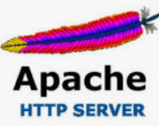

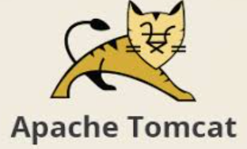

Docker Container
Docker Container
Docker Container 1
Docker Container 2
Docker Container 3
Docker Container for httpd
Docker Container for Nginx
Docker Container for Tomcat
Docker Container for XXXXXX
App A
App B
App C
Your Application's
Bins/
Libs
Bins/
Libs
Bins/
Libs
Bins/
Libs
Bins/
Libs
Bins/
Libs
Docker Engine
Docker Engine
Host OS
Host OS
Infrastructure
Infrastructure

Slide 42
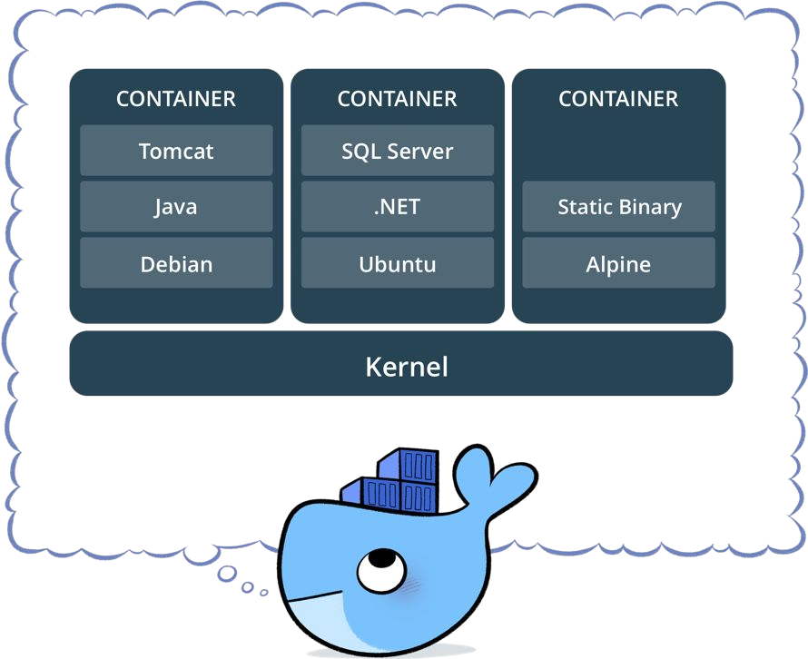
What is / Why Docker Container?
Standardized packaging for software and dependencies
Isolate apps from each other
Share the same OS kernel
Works for all major Linux distributions
Containers native to Windows Server 2016

Slide 43
B
Y
K
U
M
A
R
Notes:
https://docs.docker.com/samples/
https://docs.docker.com/get-started/

Slide 44
?
B
Y
K
U
M
A
R

Slide 45
What is Docker Client?
The Docker client ( docker ) is the primary way that many Docker users interact with Docker. When you use commands such as docker run , the client sends these commands to dockerd , which carries them out. The docker command uses the Docker API. The Docker client can communicate with more than one daemon.
Notes:
https://docs.docker.com/samples/
https://docs.docker.com/get-started/

Slide 46
B
Y
K
U
M
A
R
Notes:
https://docs.docker.com/samples/
https://docs.docker.com/get-started/

Slide 47
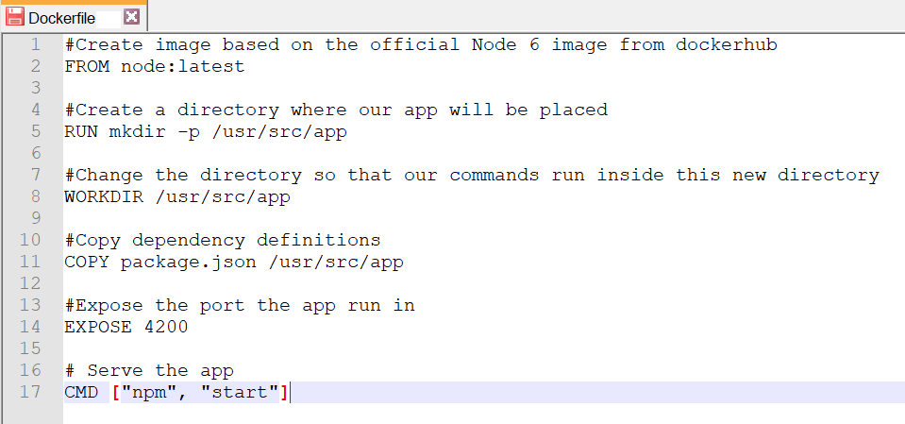
What is Dockerfile?
Notes:
#Create image based on the official Node 6 image from dockerhub
FROM node:latest
#Create a directory where our app will be placed
RUN mkdir -p /usr/src/app
#Change the directory so that our commands run inside this new directory
WORKDIR /usr/src/app
#Copy dependency definitions
COPY package.json /usr/src/app
#Expose the port the app run in
EXPOSE 4200
# Serve the app
CMD ["npm", "start"]

Slide 48
B
Y
K
U
M
A
R
Notes:
https://docs.docker.com/samples/
https://docs.docker.com/get-started/

Slide 49
?
B
Y
K
U
M
A
R
Notes:
https://docs.docker.com/develop/dev-best-practices/
https://docs.docker.com/samples/
https://docs.docker.com/get-started/

Slide 50
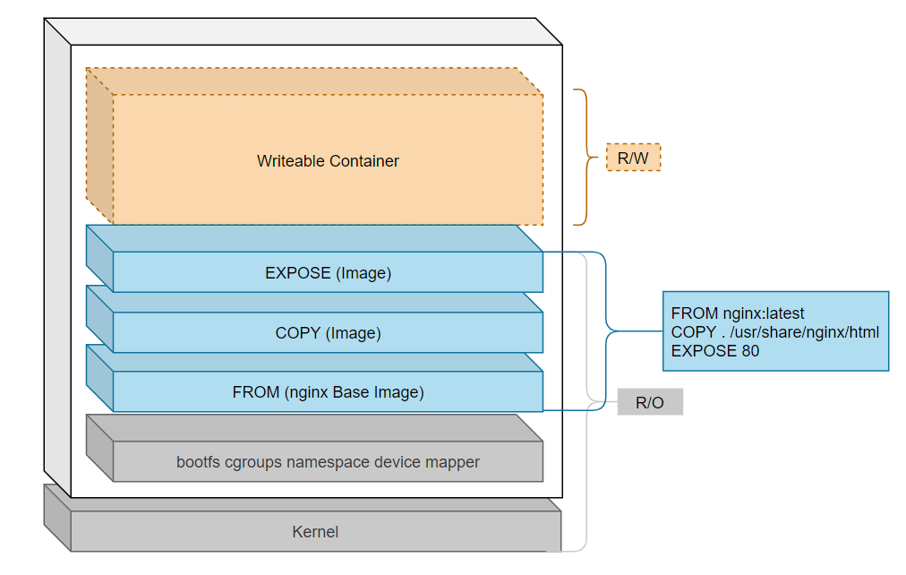
What is Docker Image and Dockerfile?
B
Y
K
U
M
A
R
Notes:
https://docs.docker.com/samples/
https://docs.docker.com/get-started/

Slide 51
What is Dockerfile?
Notes:
#Create image based on the official Node 6 image from dockerhub
FROM node:latest
#Create a directory where our app will be placed
RUN mkdir -p /usr/src/app
#Change the directory so that our commands run inside this new directory
WORKDIR /usr/src/app
#Copy dependency definitions
COPY package.json /usr/src/app
#Expose the port the app run in
EXPOSE 4200
# Serve the app
CMD ["npm", "start"]

Slide 52
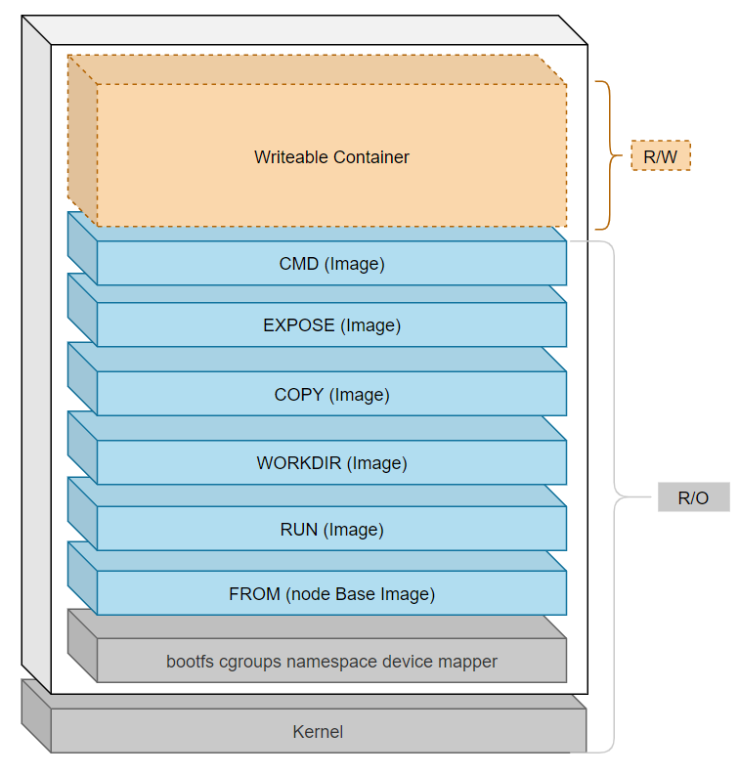
What is Docker Image?
Notes:
C:\AWS-DevOPS\VP\Udemy\Docker-Swarm\Drowing\Docker-Image-Container.drawio

Slide 53
What is Docker Image and Dockerfile together?
Notes:
C:\AWS-DevOPS\VP\Udemy\Docker-Swarm\Drowing\Docker-Image-Container.drawio
https://docs.docker.com/develop/dev-best-practices/

Slide 54
B
Y
K
U
M
A
R
Notes:
https://docs.docker.com/samples/
https://docs.docker.com/get-started/

Slide 55
?
B
Y
K
U
M
A
R
Notes:
https://docs.docker.com/samples/
https://docs.docker.com/get-started/

Slide 56
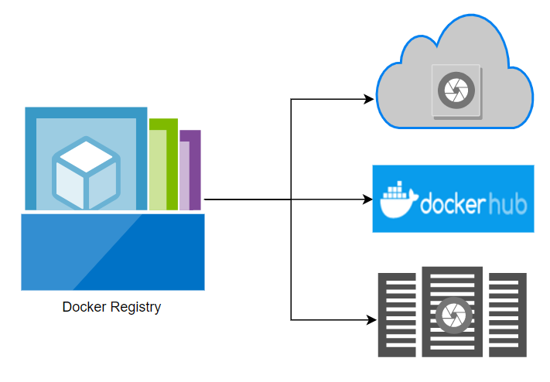
What is Docker Registry?
The Registry is a stateless, highly scalable server side application that stores and lets you distribute Docker images.
Notes:
https://docs.docker.com/samples/
https://docs.docker.com/get-started/

Slide 57
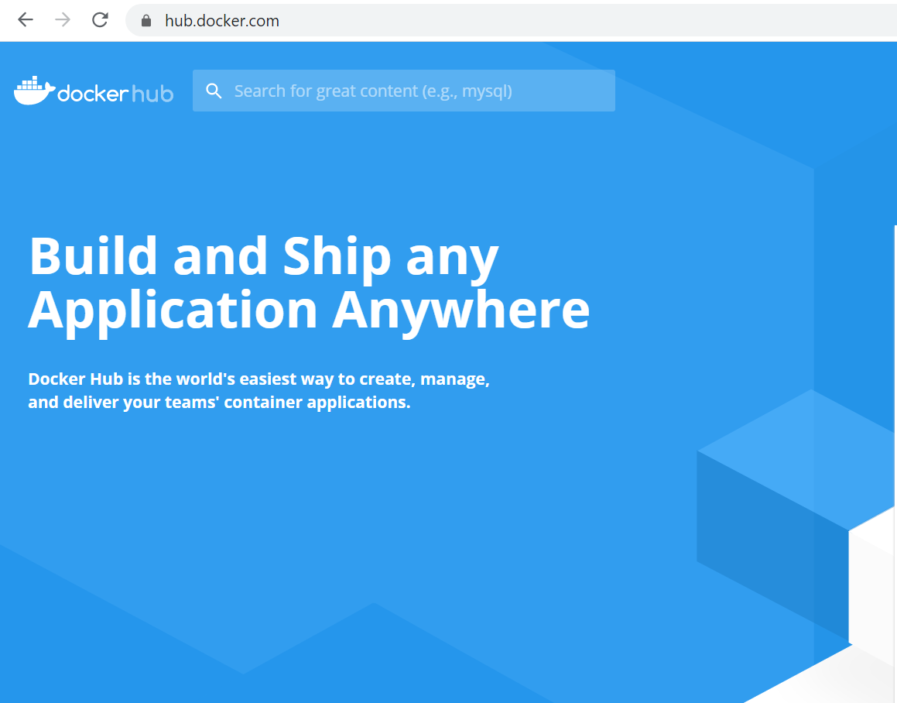
Notes:
https://docs.docker.com/samples/
https://docs.docker.com/get-started/

Slide 58
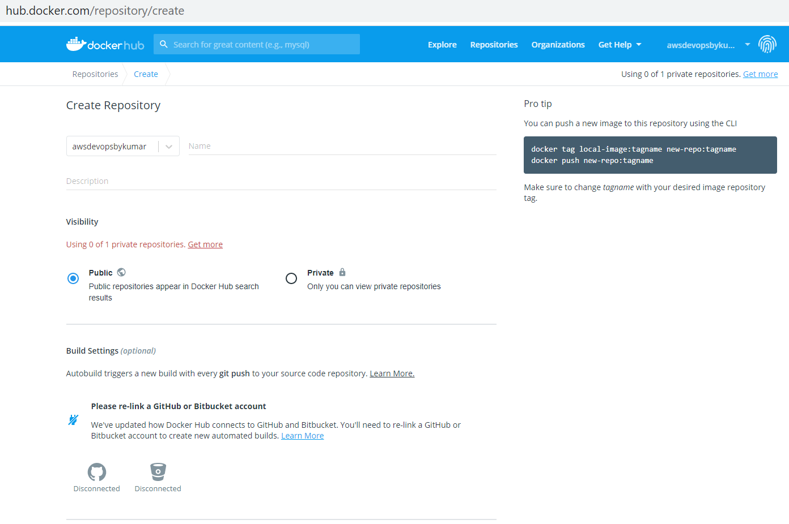
Notes:
https://docs.docker.com/samples/
https://docs.docker.com/get-started/

Slide 59
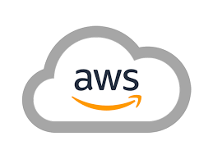
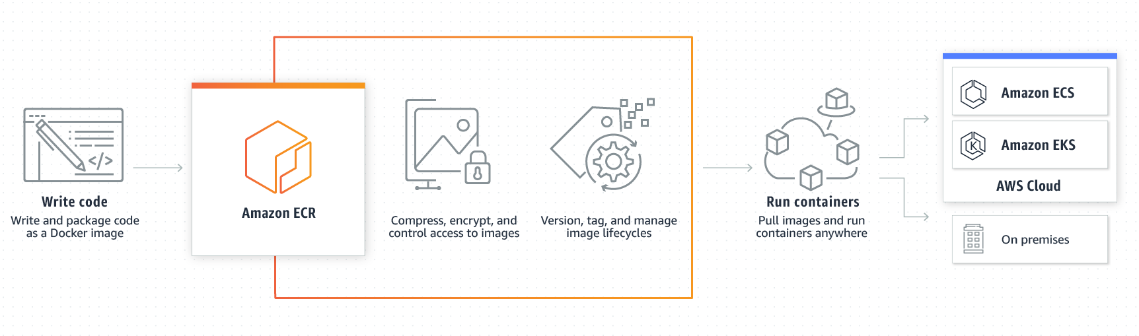
https://aws.amazon.com/ecr/
Notes:
https://docs.docker.com/samples/
https://docs.docker.com/get-started/

Slide 60
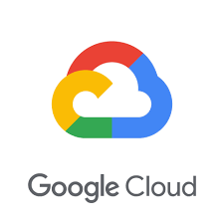
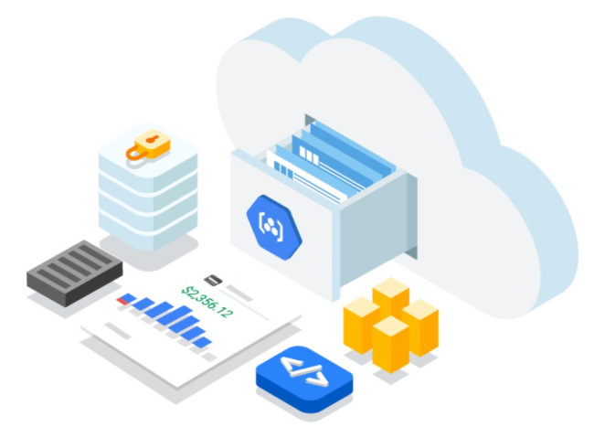
https://cloud.google.com/container-registry
Notes:
https://docs.docker.com/samples/
https://docs.docker.com/get-started/

Slide 61
B
Y
K
U
M
A
R
Notes:
https://docs.docker.com/samples/
https://docs.docker.com/get-started/

Slide 62
B
Y
K
U
M
A
R
Notes:
https://docs.docker.com/samples/
https://docs.docker.com/get-started/

Slide 63
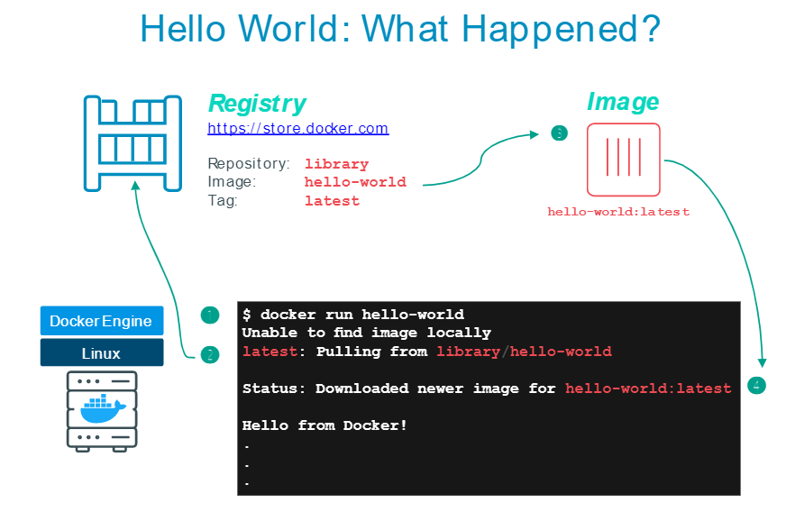
B
Y
K
U
M
A
R
Notes:
https://docs.docker.com/samples/
https://docs.docker.com/get-started/

Slide 64
Spring-Boot – H2
Spring-Boot – H2 – Ec2
AWS Ec2 – git, wget java, javac, and Maven, Docker
Docker build
Docker Hub
Docker Hub – Kubernetes / Docker Run

Slide 65
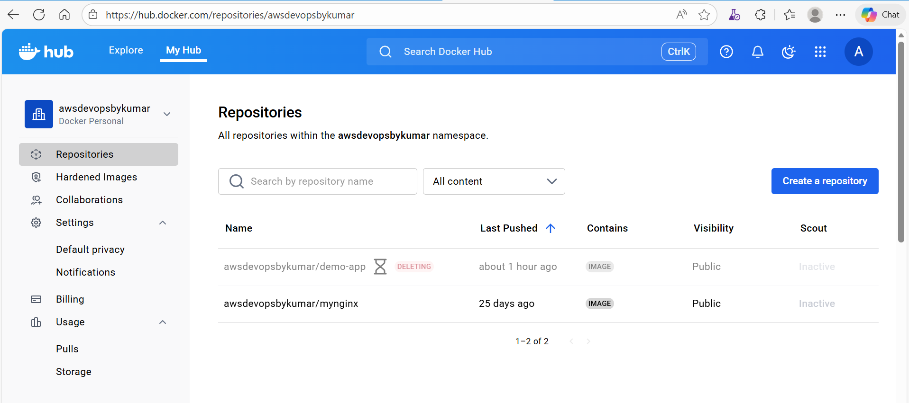
AWS –EC2
Docker
Docker login

Slide 66
AWS –EC2
Docker
Docker login

